Slide 1
Computer Arithmetic

Slide 2
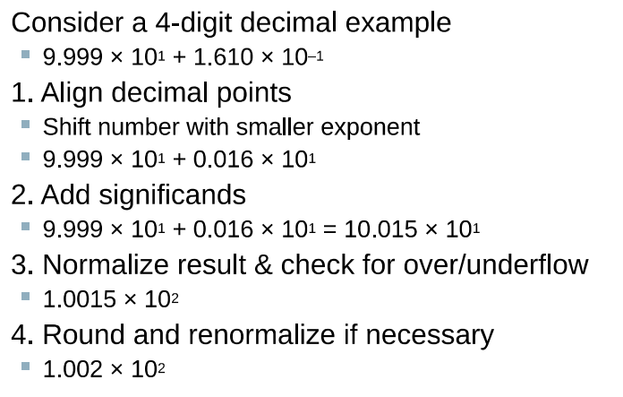
Floating point - addition

Slide 3
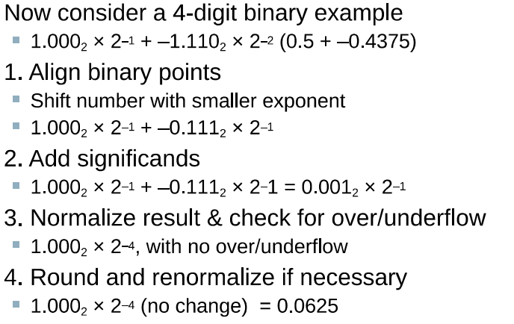
Floating point binary addition

Slide 4
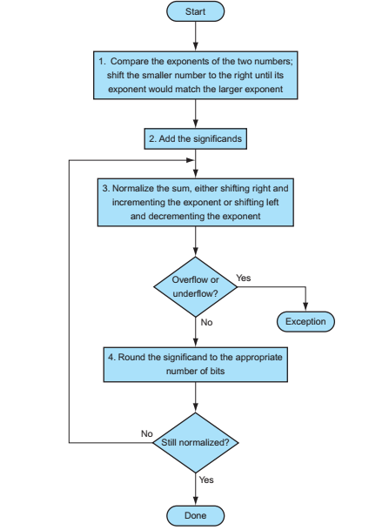
Flowchart for floating point addition

Slide 5
Floating point multiplication
﻿We start by multiplying decimal numbers in scientific notation by hand: 1.110_{ten} X 10¹⁰ * 9.200_{ten} X 10⁻⁵.
﻿Step 1: Unlike addition, we calculate the exponent of the product by simply adding the exponents of the operands together:
New exponent = 10 + (-5) = 5
Now if we consider biased exponent approach, ﻿to get the correct biased sum when we add biased numbers, we must subtract the bias from the sum:
Adding up exponents with bias- ﻿10 + 127 = 137, and -5 + 127 = 122, so
﻿New exponent = 137 + 122 - 127 = 259 - 127 = 132 (5 - 127)
and 5 is indeed the exponent we calculated initially

Slide 6
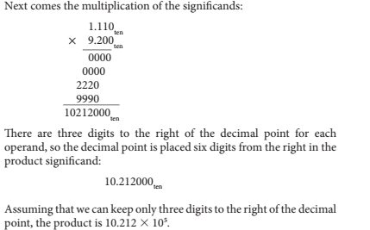

Step 2

Slide 7
Step 3: ﻿This product is unnormalized, so we need to normalize it: 10.212_{ten} X 10⁵ = 1.0212_{ten} X 10⁶
Step 4: ﻿We assumed that the significand is only four digits long (excluding the sign), so we must round the number. The number 1.0212 _{ten} X 10⁶ is rounded to four digits in the significand to 1.021_{ten} X 10⁶
Step 5: ﻿The sign of the product depends on the signs of the original operands. If they are both the same, the sign is positive; otherwise, it’s negative. Hence, the product is 1.021_{ten} x 10⁶

Slide 8
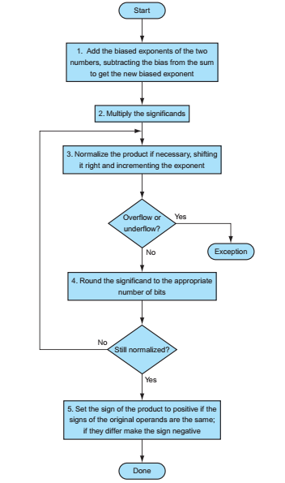
Flowchart for floating point multiplication

Slide 9
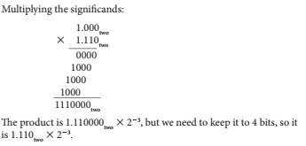
Binary floating point multiplication :
﻿Let’s try multiplying the numbers 0.5_{ten} and 0.4375_{ten},
﻿In binary, the task is multiplying 1.000_{two} x 2⁻¹ by 1.110_{two} x 2⁻²
Step 1: ﻿Adding the exponents without bias: -1 + (-2) = - 3
or, using the biased representation:
(-1 +127) + (-2 + 127)- 127 + (-1-2) + (127 + 127-127)
=- 3 + 127 = 124
Step 2:

Slide 10
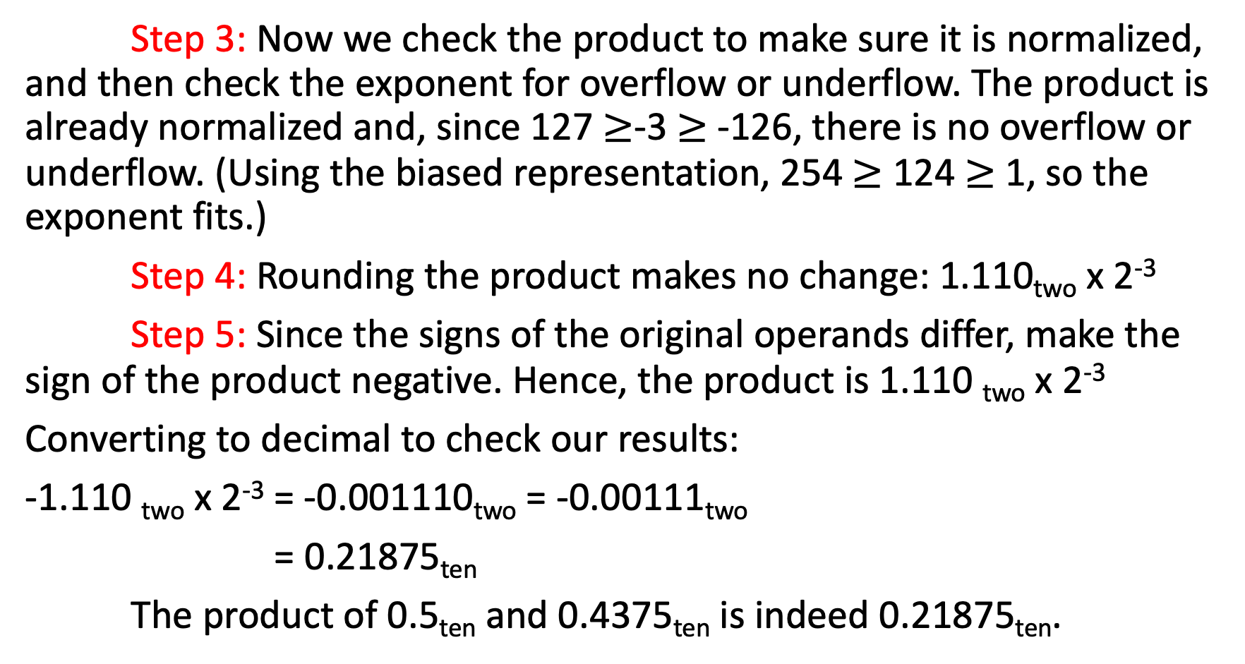
Step 3: Now we check the product to make sure it is normalized, and then check the exponent for overflow or underflow. The product is already normalized and, since 127 $≥$-3 $≥$ -126, there is no overflow or underflow. (Using the biased representation, 254 $≥$ 124 $≥$ 1, so the exponent fits.)
Step 4: Rounding the product makes no change: 1.110_{two} x 2⁻³
﻿ Step 5: Since the signs of the original operands differ, make the sign of the product negative. Hence, the product is 1.110 _{two} x 2⁻³
Converting to decimal to check our results:
-1.110 _{two} x 2⁻³ = -0.001110_{two} = -0.00111_{two}
= 0.21875_{ten}
The product of 0.5_{ten} and 0.4375_{ten} is indeed 0.21875_{ten}.

Slide 11
MIPS Floating point instructions
Floating point on MIPS was originally done in a separate chip called coprocessor 1 also called the FPA (Floating Point Accelerator). Modern MIPS chips include floating point operations on the main processor chip. But the instructions sometimes act as if there were still a separate chip.
MIPS has 32 single precision (32 bit) floating point registers.
The registers are named $f0 – $f31
$f0 is not special (it can hold any bit pattern, not just zero).
Single precision floating point load, store, arithmetic, and other instructions work with these registers.
Floating point instructions cannot use general purpose registers.
Only floating-point instructions may be used with the floating-point registers.

Slide 12

﻿MIPS supports the IEEE 754 single precision and double precision formats with these instructions:
■ Floating-point addition, single (add.s) and addition, double (add.d)
■ Floating-point subtraction, single (sub.s) and subtraction, double (sub.d)
■ Floating-point multiplication, single (mul.s) and multiplication, double (mul.d)
■ Floating-point division, single (div.s) and division, double (div.d)
■ Floating-point comparison, single (c.x.s) and comparison, double (c.x.d),
where x may be equal (eq), not equal (neq), less than (lt), less than or equal (le), greater than (gt), or greater than or equal (ge)
■ Floating-point branch, true (bclt) and branch, false (bclf)

Slide 13

﻿The MIPS designers decided to add separate floating-point registers—called $f0, $f1, $f2, …—used either for single precision or double precision.
Hence, they included separate loads and stores for floating-point registers: lwcl and swcl.
The base registers for floating-point data transfers which are used for addresses remain integer registers. The MIPS code to load two single precision numbers from memory, add them, and then store the sum might look like this:

